Slide 1
NFPD Balance Sheet – July 2023
Note: Reserved amount differs from Acct 1028 by $2,254.64, interest to be accrued in Gen Op Fund
Total Unreserved Funds | $941,288.23
Items of note:
Total Unreserved = (Total Gen Op Fund, Checking/Savings, Receivables) – (Reserve Fund, Apparatus Fund, Pension Fund, Payables)
Last year in July 2022:
Total funds = $800,606.97
Total unreserved funds = $596,873.77

Slide 2
NFPD Income – July 2023
To date received $1,146,921 in tax revenue + $1602 (donations) + $5,519 (uncategorized) +$14,695 in interest income
No “Other Income” received in July
District has received 91% of total 2023 income through July

Slide 3
NFPD Expense – July 2023
No “Other Expenses” reported for July
$30K underspent for July
YTD underspent by $12,642

Slide 4
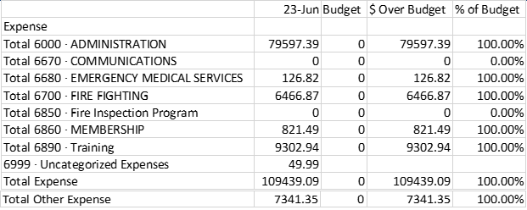
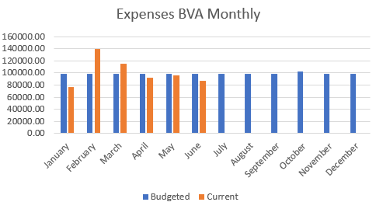
NFPD Finance – July Summary
Offset in June expense in Treasurer’s report reconciled:
Nederland Fire funds are in good shape for month ending July 2023
Bar graph showed $92K while total spend was $109K => difference as $13,073 of capital outlay and negative Training expense in May that threw off spreadsheet calculations

